Slide 1


Real Estate Market Trend Exploration-using Predictive Models
Notes:
Exploring market trends and dynamics using predictive models for Real Estate Market in San Francisco Bay Area

Slide 2
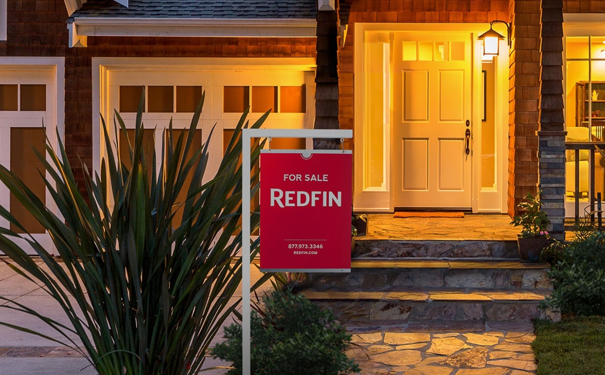
OBJECTIVE
The primary objective of this project is to comprehensively analyze the California Bay Area real-estate market, uncovering underlying trends and predictive patterns to facilitate informed decision-making for stakeholders.
Specifically, the project aims to investigate fluctuations in housing prices, identify key drivers of market dynamics, and develop predictive models to forecast future trends.

Slide 3
METHODOLOGY
Data Collection
Data Pre-processing
Exploratory Data Analysis
Predictive Modelling
Comparative Analysis
Interpretation

Slide 4
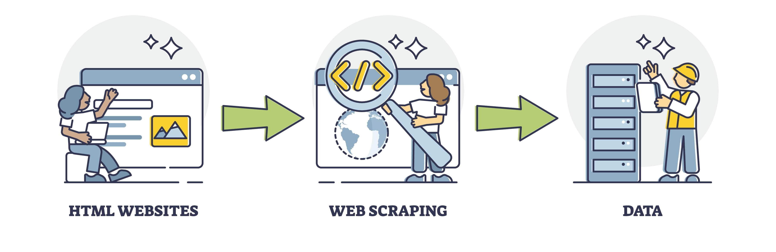
DATA COLLECTION THROUGH WEB SCRAPPING
Web scrapping a process of extracting data from websites.
Beautiful Soup, a Python library specifically designed for web scraping, streamlines the data collection process by providing tools and functionalities tailored for this purpose.
Web scraping in real estate enables access to valuable market data for analysis, enhancing decision-making through insights derived from gathered information.

Slide 5
DATA COLLECTION THROUGH WEB SCRAPPING
Overview of Web Scraping Process:
Accessing Websites
Extracting HTML Data
Parsing and Organizing Information
Key Benefits:
Rapid data acquisition: Collecting diverse real-time information from online sources.
Enhanced accuracy: Ensuring data reliability through automated extraction techniques.
Competitive advantage: Leveraging insights for strategic market positioning and investment decisions.

Slide 6

DATA PREPROCESSING
Identify missing data
Outlier detection
Data accuracy
Redundancy elimination
Missing Data Handling: Identify and handle missing values using imputation techniques.
Outlier Detection and Treatment: Detect outliers and treat them to prevent skewing analysis results.
Data Accuracy Verification: Validate data accuracy and correct inaccuracies.
Redundancy Elimination: Identify and remove redundant features or observations.
Efficient pre-processing ensures data integrity, laying the groundwork for meaningful analysis.

Slide 7
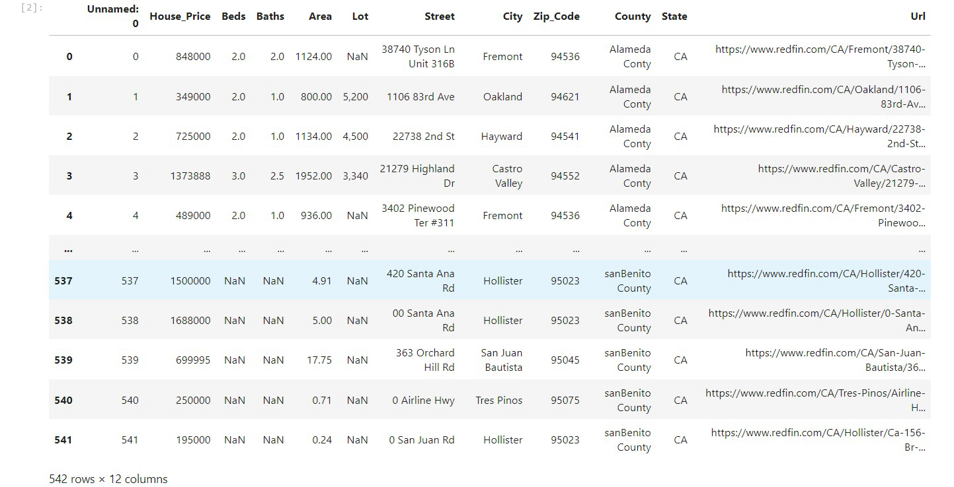
Notes:
Which features have the highest proportion of missing values?
Lot has the highest proportion of missing values with 168 out of the total records.
4.⁠ ⁠Are there any correlations between missing values in different features?
There seems to be a correlation between missing values in certain features. For example, the features Street, City, Zip-Code, County, State, and Uri have similar patterns of missing data. This might suggest that if one is missing, the others are likely to be missing too, possibly due to the way data is collected or input.

Slide 8
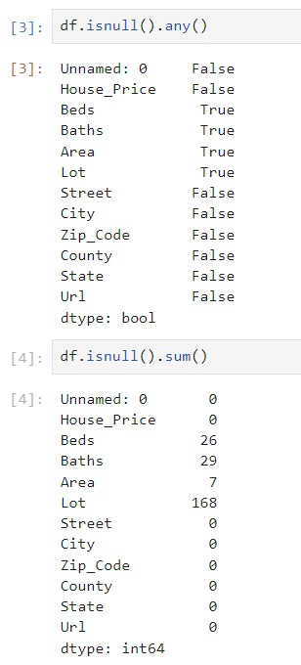
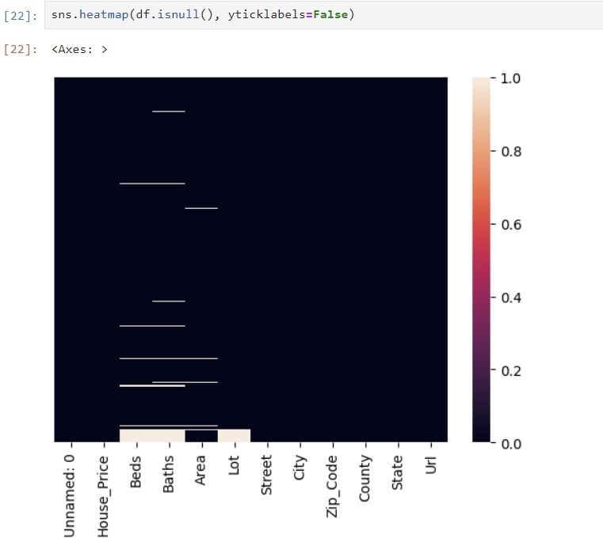
Notes:
What is the distribution of missing values across different features?
Beds: 26 missing values
Baths: 29 missing values
Area: 7 missing values
Lot: 168 missing values
Are there any patterns or clusters of missing values in the heatmap?
From the missing value counts, there doesn't appear to be a clear pattern or cluster of missing values. However, a heatmap visualizing the missing values across features would provide a clearer picture.

Slide 9
EXPLORATORY DATA ANALYSIS
Conduct exploratory analysis to uncover trends, correlations, and outliers within the dataset.
Utilize descriptive statistics, data visualization techniques, and advanced analyses to reveal insights.
Importance:
EDA provides crucial insights into the dataset's structure, relationships, and patterns.
Uncovering hidden trends and outliers facilitates informed decision-making and strategy formulation.

Slide 10
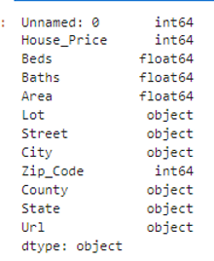
EXPLORATORY DATA ANALYSIS
SUMMARY STATISTICS House Price: Mean house price is $1.38 million (SD: $1.30 million), ranging from $2,300 to $11.5 million, with a median of $995,000.
Bedrooms (Beds): Mean number of bedrooms is 3.26 (SD: 1.22), ranging from 0 to 16.
Bathrooms (Baths): Mean number of bathrooms is 2.44 (SD: 1.08), ranging from 1 to 16.
Area: Mean property area is 2,029 sq ft (SD: 1,262 sq ft), ranging from 500 sq ft to 15,105 sq ft.
Zip Code: The dataset covers multiple zip codes, with a mean zip code of 94784. Range: (min) to (max).
We analyze predictor variables like house price, beds, baths, and location details to grasp housing market dynamics. Visualizations and statistical analyses elucidate trends and correlations, aiding informed real estate decisions.

Slide 11
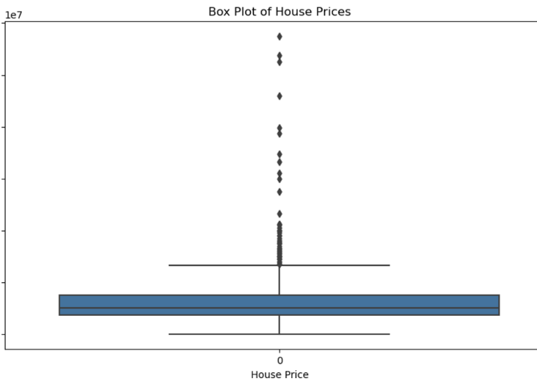
EXPLORATORY DATA ANALYSIS​
The box plot analysis reveals a median house price of $200,000, with notable outliers ranging from $300,000 to $1.2 million. Positive skewness is evident, with a concentration of outliers on the higher end. Further investigation into factors driving high-value outliers could offer insights into market dynamics and investment opportunities.

Slide 12
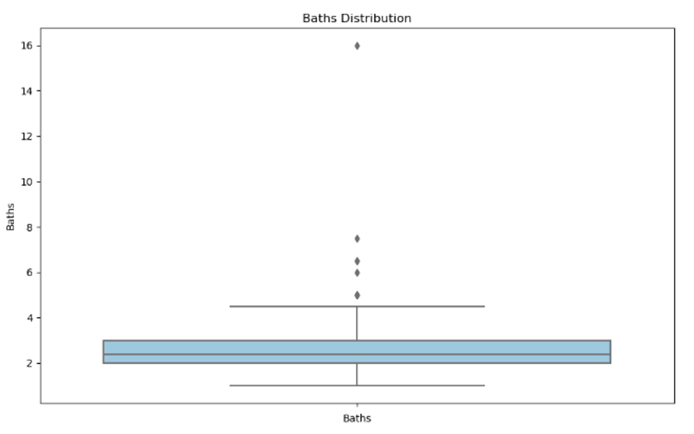
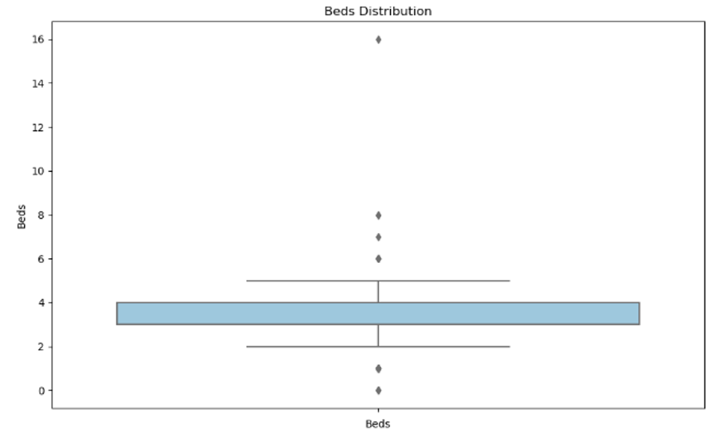
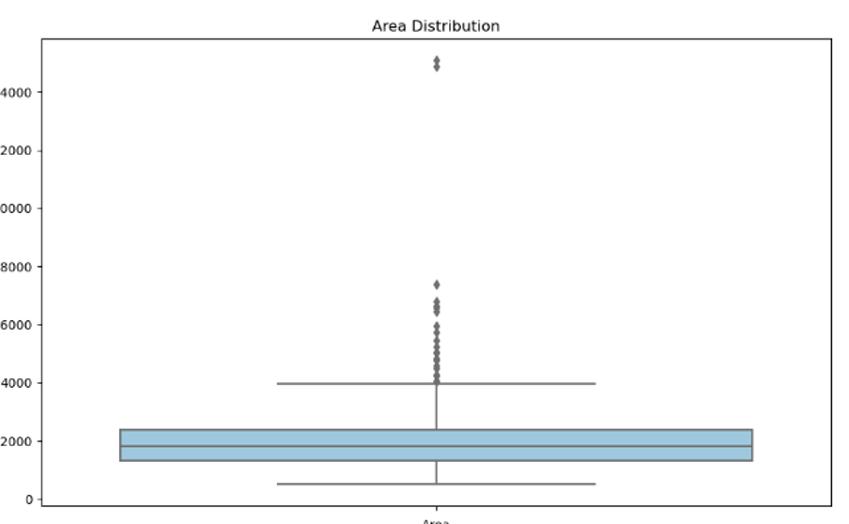
EXPLORATORY DATA ANALYSIS

Slide 13
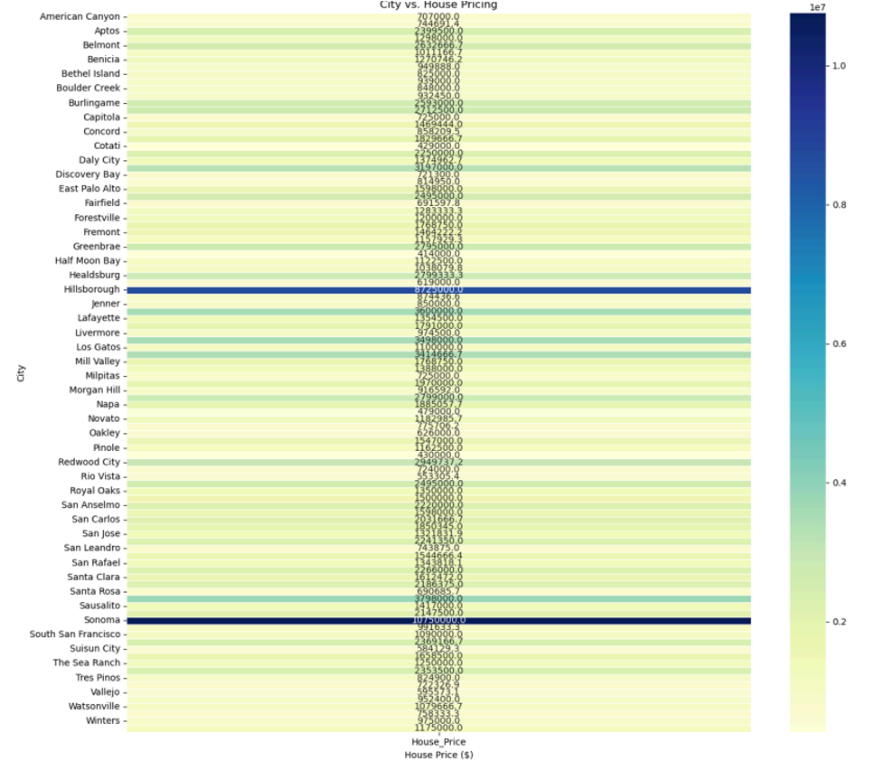
Heatmap Overview:
- Represents relationship between cities and average house prices.
- Each row corresponds to a city, color intensity indicates average price.
Color Representation:
- Darker shades signify higher prices; lighter shades, lower prices.
- Intensity correlates with the magnitude of average house price.
Numerical Representation:
- Numbers in each cell denote exact average house price for the city.
Conclusion - Sonoma and Hillsborough:
- Dark intensity in heatmap for Sonoma and Hillsborough.
- Suggests highest average house prices compared to other cities.
Interpretation:
- Darker shades in heatmap signify areas with potentially higher property values. Useful for identifying regions with varying housing market dynamics.

Slide 14
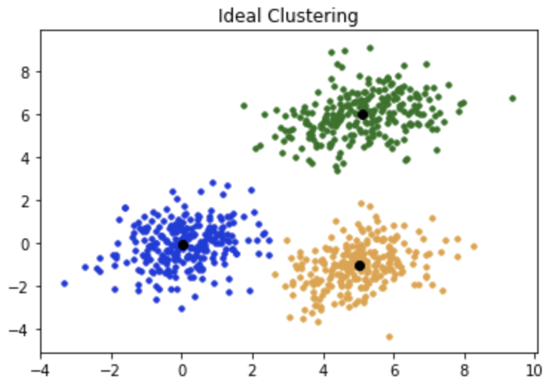
PREDICTIVE MODELLING (K-Means)
K-means is a popular clustering algorithm used in data mining and machine learning. Its primary goal is to partition a set of data points into K clusters where each data point belongs to the cluster with the nearest mean (centroid).
Select the number of clusters
Select random points as centroids
Assign points to the closest cluster centroid
Calculate the variance
Reassign each data point to the new closest centroid

Slide 15
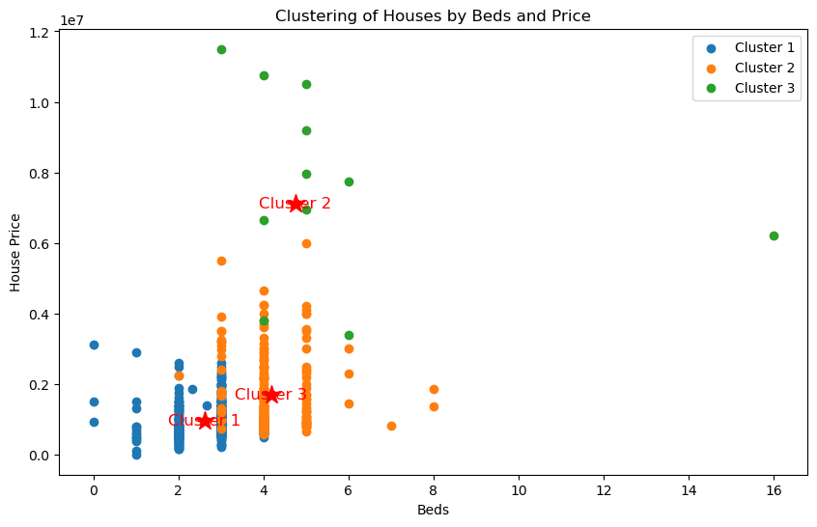
Exploring housing data through color-coded clusters reveals distinct market segments. Blue cluster homes, with 1 to 3 bedrooms, are budget-friendly. Green clusters, boasting moderate bedrooms but higher prices, suggest luxury or prime location properties. Orange clusters present medium-sized family homes. While outliers like a 16-bedroom mansion priced at $6.2 million exist, cluster center markings help understand each group's core traits.
Notes:
Color-Coded Clusters:
Blue (Cluster 1): Houses with 1 to 3 bedrooms, priced below $400,000.
Green (Cluster 2): Moderate bedrooms (3 to 4), higher prices, many above $600,000, some exceeding $1,000,000.
Orange (Cluster 3): Wide bedroom range (2 to 8), prices $600,000 to $1,200,000.
Distribution and Characteristics:
Cluster 1 (Blue): Lower-priced, likely economical or smaller housing options.
Cluster 2 (Green): Higher-priced, includes luxury homes or properties in high-value areas.
Cluster 3 (Orange): Moderate size and price, representing medium-sized family homes.
Outlier:
Green outlier on the far right: 16 bedrooms, priced at $6,200,000. May not be representative and can be disregarded.
Cluster Center Markings:
Red star markers indicate center of each cluster.
Helps understand core characteristics; e.g., Cluster 1 centered at lower prices and bedroom counts, Cluster 2 at higher price point.

Slide 16
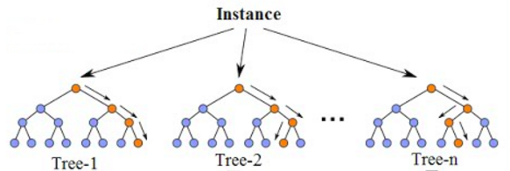
PREDICTIVE MODELLING (Random Forest)
Random Forest is an ensemble learning method used for classification and regression tasks.
It constructs multiple decision trees during training and outputs the mode (classification) or mean prediction (regression) of the individual trees.
Create decision trees
Analyze the results
Combine the results
Split the dataset into subset

Slide 17
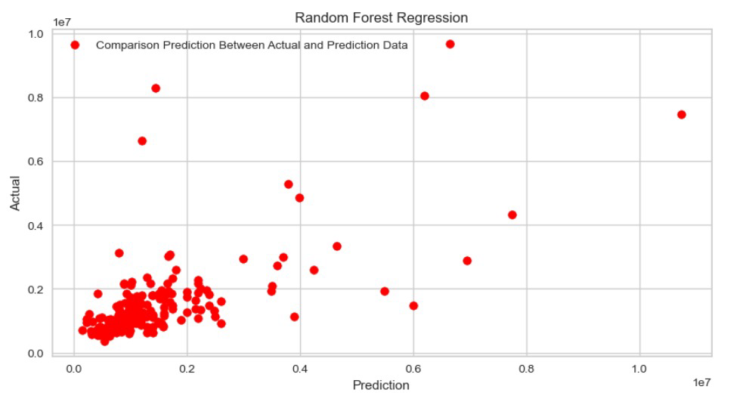
PREDICTIVE MODELLING (Random Forest)

Slide 18
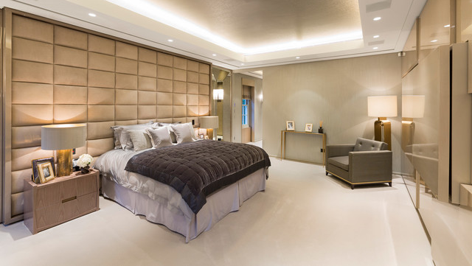
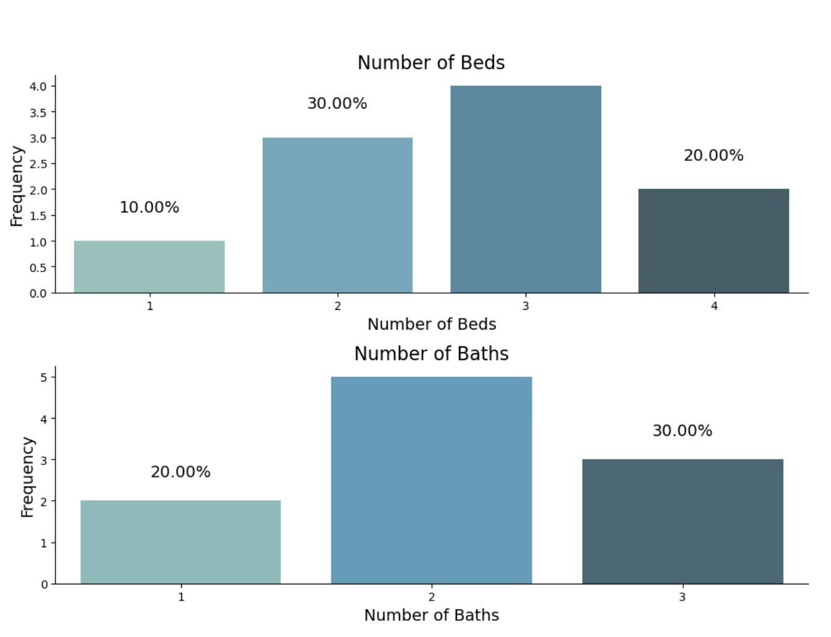
DATA VISUALIZATION
HOW IS THE HOUSING DISTRIBUTION AFFECTED WITH REGARDS TO THE BEDROOMS AND BATHROOMS?
Notes:
Here we are trying to figure out the number or the percentage of Houses classified based on the counts of bedrooms and bathrooms each property holds distributed across all the counties. Observation: Houses with 3 bedrooms are the most common among the listings at around 40% and houses with 2 baths are frequently used at around 45% as per the graphs.

Slide 19
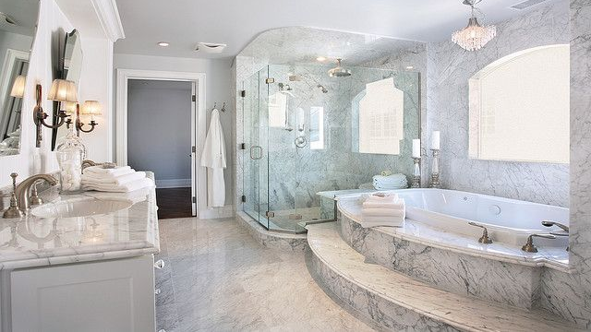
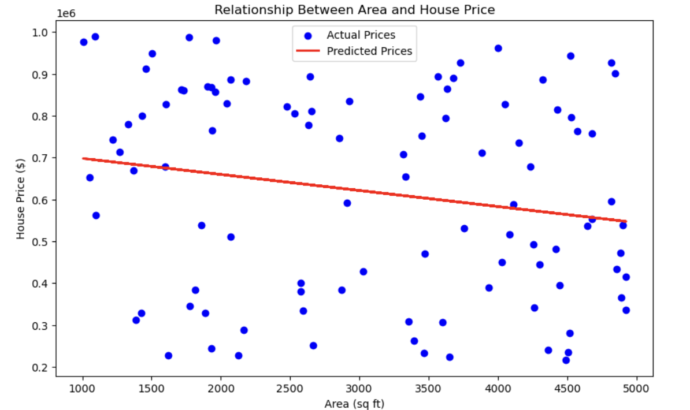
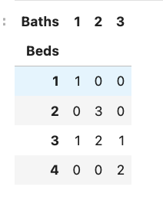
How is the 'Area' and the 'House Price' related?
What are the combination of beds and baths seen more commonly in the properties across the Counties?
Notes:
Most Common combination of Beds and Baths across all the Counties: Most common combination chosen by people across all the counties as per the cross tabulation is 2 Beds and 2 Baths.
Price Trend as per the Area/sqft of the properties: We noticed a steep increase in prices with the increase in Area of the properties.

Slide 20
CONCLUSION
Luxury: Sonoma and Hillsborough as per the heatmap indicates that these cities have the highest average house prices, reflecting their status as affluent, desirable locations with limited housing supply and a focus on luxury real estate.
Most Commonly Sorted Properties: Houses with 3 bedrooms are the most common among the listings at around 40% and houses with 2 baths are frequently used at around 45% as per the graphs.¶
Most Common combination of Beds and Baths across all the Counties: Most common combination chosen by people across all the counties as per the cross tabulation is 2 Beds and 2 Baths.
Price Trend as per the Area/sqft of the properties: We noticed a steep increase in prices with the increase in Area of the properties.
Price Drivers: Both the number of bedrooms and bathrooms, as well as the total area, are key drivers of house prices. The data suggests that larger area, more bedrooms, and more bathrooms are associated with higher house prices.
Overall, the charts suggest that while basic features like bedrooms and bathrooms correlate with price, the total area of a house provides a nuanced view of its value, potentially indicating quality or additional features not captured merely by the number of bedrooms or bathrooms.

Slide 21

ANY QUESTIONS...

Slide 22
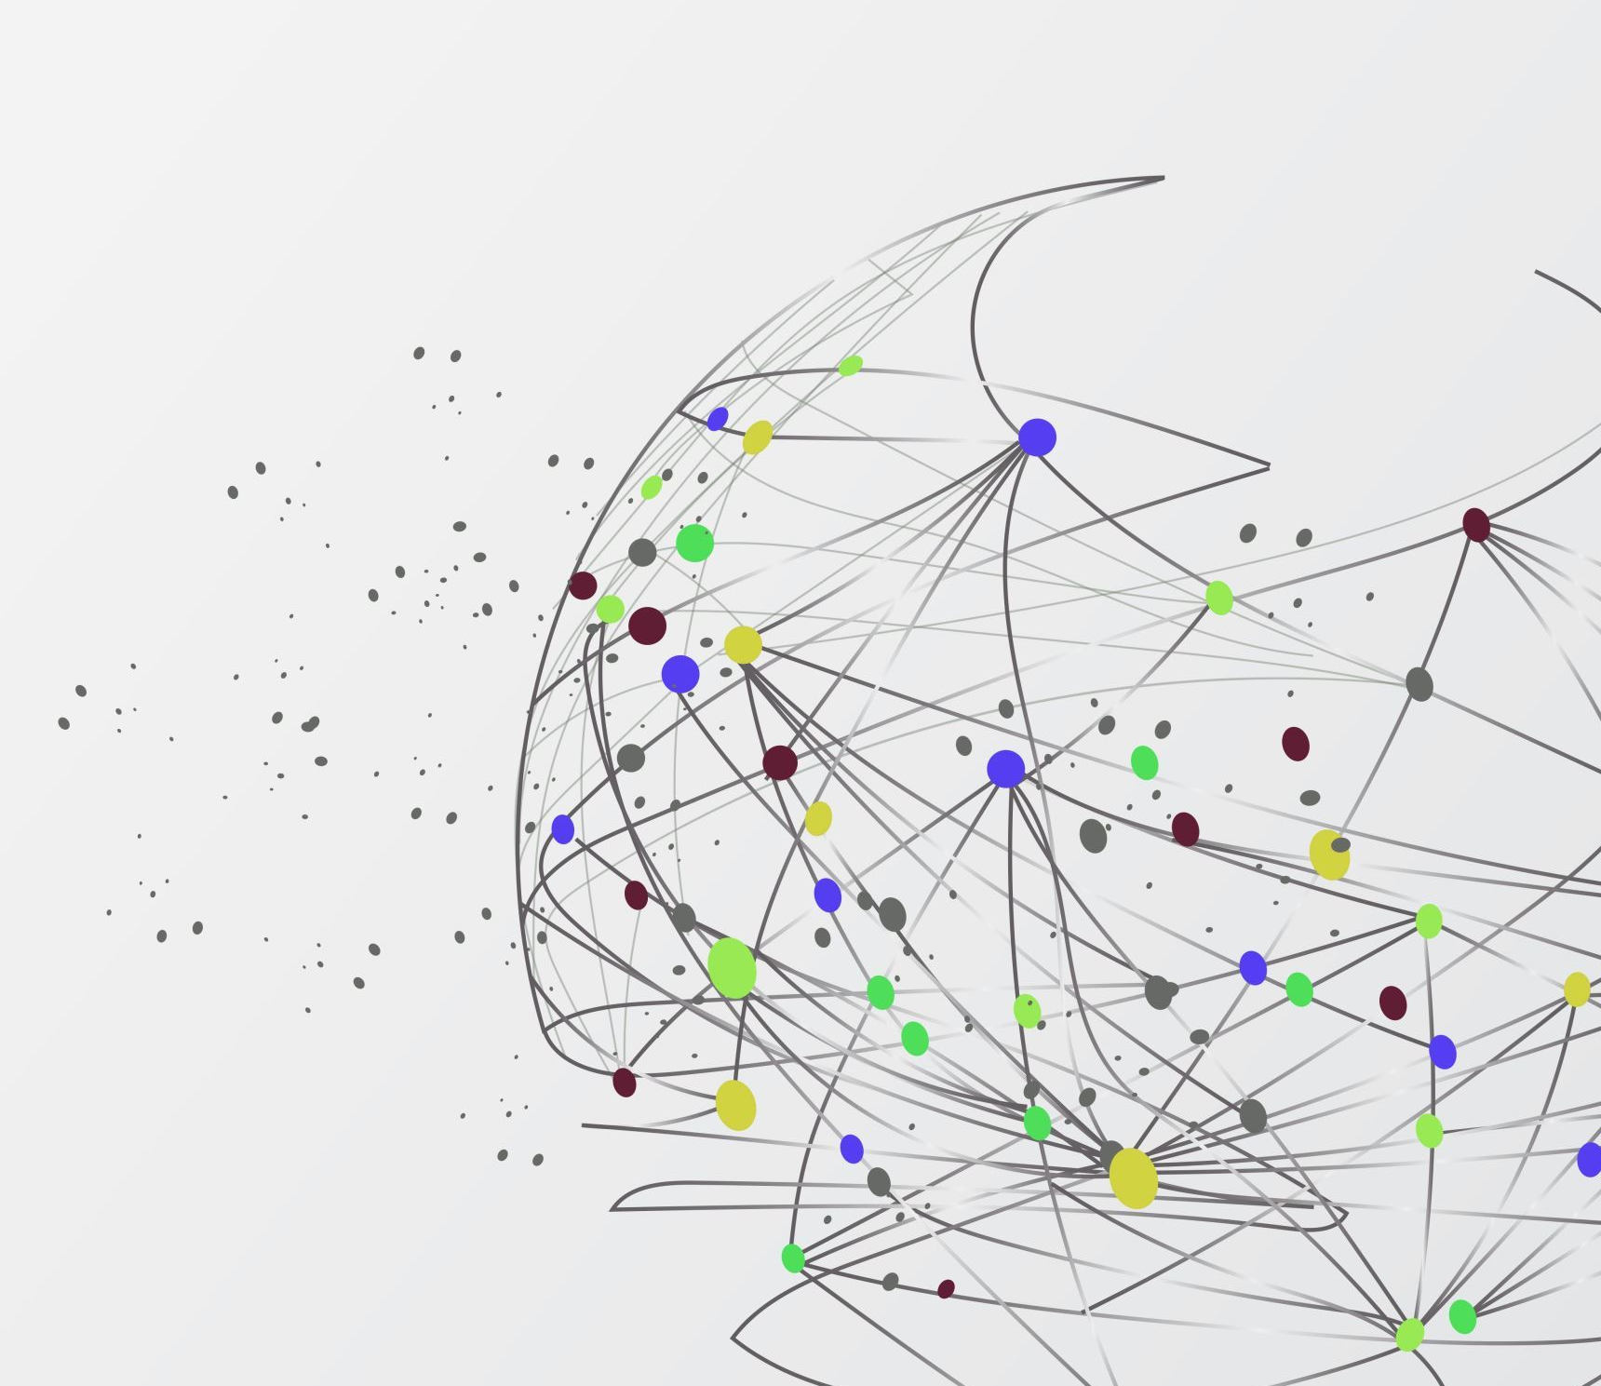
THANK YOU...

